Slide 1
GRAD BASH
UNIVERSAL STUDIOS
Saturday April 5, 2025
Class of 2025

Slide 2
THINGS TO KEEP IN MIND
GRAD BASH IS A SCHOOL FUNCTION
From the time you arrive at RMSH, Saturday morning, until the time return to RMSH on Sunday Morning.
RULES
Rules are set to protect you and keep you and others safe, NOT to prevent you from having fun.
CHOICES
Some bad decision can have repercussions that will last the rest of your life.

Slide 3
THINGS TO KEEP IN MIND
ATTENDANCE
You must be in school the day before to participate in
GRAD BASH.
PARKING
If you are driving to school and leaving your car over night.
•The school is not responsible for your car or its contents.
•Park in North Campus – Teacher Parking Lot

Slide 4
BUS LISTS
Next week check the bus lists in front of the Auditorium.
Your name should be on the list.
If it’s not there, you are NOT going to Grad Bash.
If there is a problem, solve it now, NOT “Later”
Later will be too late.
Do not expect anyone to solve your problem the day of Grad Bash. It will not happen.
You can not sell your ticket to another student. There are no refunds, if you miss the bus, you don’t get your money back.

Slide 5
BUS LISTS
5 BUSES
BUS 1 - Minions - Yellow - Ojeda
BUS 2 - Evil Minion - Purple - Blanco
BUS 3 - Gru - Blue - Justice
BUS 4 - Vector - Orange - Molina
BUS 5 - Margo - Pink - Hughes

Slide 6
GROUPME
QR CODE
BUSES
YOU WILL NEED TO CHECK YOUR PHONE PERIODICALLY FOR IMPORTANT INFORMATION/UPDATES. EACH BUS WILL HAVE ITS OWN QR CODE. BE SURE TO JOIN GROUPME WHEN YOU SELECT YOUR BUS ON FRIDAY, MARCH 14TH IN THE AUDITORIUM DURING LUNCH.

Slide 7
GRAD BASH SCHEDULE
9:15 AM STUDENTS WILL REPORT TO THE SCHOOL’S COURTYARD.
CHECK IN WILL BE IN THE GYM.
DON’T FORGET ID AND MONEY.
CHAPERONES WILL CHECK STUDENT IDS, DRESS
CODE IN THE GYM. (CHECK ATTENDANCE) YOU WILL
PLACE YOUR BAG ON A BLUE TARP BY BUS NUMBER BEFORE
WALKING INTO GYM.
10:30 AM BUSSES ARRIVE AT RMSH / LOAD BUSSES
11:00 AM DEPART RMSH
1:00 PM ARRIVAL AT FORT PIERCE SERVICE PLAZA
- STUDENTS CAN GET OFF TO GO TO THE BATHROOM
BUT ARE STRONGLY DISCOURAGED FROM GETTING
FOOD OR DRINKS.
1:30 PM DEPART FORT PIERCE SERVICE PLAZA (CHECK ATTENDANCE)

Slide 8
GRAD BASH SCHEDULE
3:30 PM ARRIVE AT UNIVERSAL ORLANDO (PURPLE PARKING LOT)
4:00 PM ENTER UNIVERSAL FOR MIX-IN
7:00 PM GRAD BASH BEGINS
1:00 AM REPORT TO THE SPECIFIED AREA TO DEPART UNIVERSAL ORLANDO
(REPORT TO DESIGNATED - BAKE MY DAY - MINION LAND AT 12:40 AM WALK TO PURPLE PARKING LOT BOARD BUS AND CHECK ATTENDANCE)
1:45 AM STOP AT CANOE CREEK REST PLAZA
2:15 AM DEPART CANOE CREEK REST PLAZA (CHECK ATTENDANCE)
5:30 AM STUDENTS WILL BE WOKEN UP TO START TEXTING THEIR
PARENTS TO INFORM THEM THAT THEY ARE 60/45
30/15 MINUTES AWAY. THIS WILL SPEED UP PARENT PICK UP.
6:15 AM ARRIVAL AT RMSH / DEPART RMSH WITH YOUR PARENT.

Slide 9
WHAT TO WEAR
*Review the Dress Code Handout*
ACCESSORIES – SUNGLASSES, HATS AND BELTS.
BAGS/PURSES – ANY BAGS AND PURSES MUST BE UNDER THE SIZE OF 8.5 X 5.5 (HALF A SHEET OF PAPER)
TOPS/SHIRTS – CASUAL TOPS AND T-SHIRTS, NO MIDRIFF SHIRTS, SHIRT SLEEVES MUST BE 3 INCHES WIDE, NO HALTER TOPS, BRAND NAME(NIKE, ADIDAS ETC.) ARE ALLOWED, NO UNDERSHIRTS AS AN OUTER GARMENT, JACKETS ARE ALLOWED (NO SCHOOL JACKET)
BOTTOMS – JEANS, LEGGINGS, RUNNING SHORTS ARE PERMITTED. (NOTHING TORN)
SHOES – COMFORTABLE SHOES, SNEAKERS, BOOTS CLOSED TOE SHOES ONLY.

Slide 12
WHAT NOT TO WEAR
Clothing that exposes excessive skin that may be viewed as inappropriate
Tanks tops, undershirts, sleeveless tops (less than 3 inches)
Clothing with obscene, offensive language or graphics
Area codes displayed on clothing
Clothes that are too tight or revealing such as spandex bodysuits
Visible under garments
Tops that show midriff or cleavage
Short shorts showing too much skin
Dress, skirt and romper hemlines must be no shorter than mid thigh
Pants/shorts falling below the waist
Accessories such as chains, spiked collars, studded/spiked belts, or accessories that include sharp objects.
High school team, name, logo or mascot
Jerseys of any kind (including college and professional)
Large backpacks or purses larger than 8.5 x 5.5
Matching or like attire

Slide 13
WHAT TO BRING
PHOTO ID’S
SMALL PURSE (FANNY PACK SIZE)
SWEATER/JACKET FOR THE BUS
MONEY TO EAT, SOUVENIRS
IF YOU ARE BRINGING ITEMS OF VALUE, IT MEANS THAT YOU ARE RESPONSIBLE FOR YOUR ITEMS.
DO NOT LEAVE ANY ITEMS ON THE BUS.
WE DO NOT CLAIM RESPONSIBILITY FOR LOST OR STOLEN ITEMS.
HAVE A GOOD BREAKFAST IN THE MORNING.
USE THE BATHROOM BEFORE ENTERING GYMNASIUM.

Slide 14
WHAT NOT TO BRING
WATER BOTTLES
Food
Book Bags
Blankets
Speakers
Valuable items
Inappropriate clothing
Medication (proper form needed)
No glass containers i.e. perfume, cologne, body spray
No open water bottles
(Anything inappropriate will be confiscated)

Slide 15
MORE ON MEDICATION
MEDICATION (FORM 2702)
Any prescription or over-the-counter medication must be listed on the Medical Situation/Special Needs form. A copy of this form must be kept with the individual requiring the medication and with the lead chaperone.
See Mrs. Ojeda and submit form by
TUESDAY, APRIL 1ST

Slide 16
K-9 SEARCH AND FRIENDLY FRISK
AT RMSH:
We will conduct a canine police search of all Grad Bash attendees prior to loading the buses.
At Universal Studios:
Each student and chaperone will undergo a “friendly frisk” prior to entering all events to check for cigarettes, alcohol, illegal substances, weapons, and other prohibited items.
Due to increased security concerns, all guest bags will be searched prior to entering any Grad Bash event. In other words, if you don’t need it, or don’t plan to use it, don’t bring it to Grad Bash.

Slide 17
THE TRIP TO
YOU DO NOT HAVE ASSIGNED SEATS, BUT ONCE YOU SIT IN A SEAT, YOU HAVE MADE A CHOICE.
The rest stop has 30 minute time limit. The longer it takes us to depart the rest stop, the less time you have at the park. Your trip, your memories, they can be of a turnpike plaza or of the park.
Although there is an emergency bathroom on the bus, avoid using it at all costs. Use the school’s restroom prior to leaving.
Don’t exit the bus without some kind of identification. If you lose your ticket or wristband, there are no replacements.
Food and drinks will not be allowed on the bus and will be confiscated if found.
Chaperones are assigned per bus. All chaperones are authorized to write referrals for misconduct. Misconduct at Grad Bash WILL result in loss of prom and/or graduation privileges.

Slide 18
AT GRAD BASH
WHEN ENTERING THE PARK YOU ARE SUBJECT TO THE RULES AND DECISIONS OF UNIVERSAL AND THEIR STAFF. WE ARE NOT COMING TO SAVE YOU.
Keep your receipts for EVERYTHING you purchase.
There are many plain clothed security monitors watching for shoplifters. They may ask to see your receipts.
Anyone caught shoplifting or involved in any misconduct will be turned over to Orlando authorities.
Be careful who you hang around with, “guilty by association” is a thing.
If caught, your parents will be called to pick you up. In addition, you will NOT be allowed to attend Prom and Graduation.

Slide 19
AT GRAD BASH (CONT.)
IF YOU MAKE PURCHASES WHEN YOU ARRIVE, YOU WILL HAVE TO EITHER CARRY IT WITH YOU ALL NIGHT OR rent a locker.
If you decide to wait until the end of the night, they may have run out of the item you wanted.
Either way, it’s your decision…choose wisely!
BUSES WILL TAKE YOU RIGHT INTO THE PARK, AND WE WILL TELL YOU WHERE TO MEET THE BUS AFTERWARDS.
YOU ARE EXPECTED TO REMAIN PROPERLY DRESSED THROUGHOUT THE NIGHT.
CHAPERONE HEADQUARTERS ARE LOCATED AT A PRE-DETERMINED AREA OF THE PARK. RMSH CHAPERONES MAY NOT BE THERE, BUT IF YOU HAVE ANY QUESTIONS, PLEASE USE THE FACILITIES FOR ASSISTANCE.

Slide 20
AT GRAD BASH (CONT.)
GRAD BASH ALLOWS YOU FULL ACCESS TO BOTH UNIVERSAL STUDIOS AND ISLANDS OF ADVENTURE.
City Walk is NOT open to YOU.
Universal Hosts/Hostesses will be stationed throughout the exit route to answer questions and direct attendees to the correct locations.
Your wristband also tells you which exit you should take. PURPLE PARKING LOT . If you leave through the wrong exit, you will be walking for MILES.
You should be at the meeting location by 12:45 am. (MINION LAND - BAKE MY WAY) Do not keep others waiting. Failure to be on time may jeopardize future participation in school activities. (PROM)
Make a bathroom stop before leaving the park around 12:30 am.
Do not use the bus restroom.

Slide 21
GRAD BASH DRESS CODE AGREEMENT
AGREEMENT IS DUE
BY MARCH 14TH, BEFORE YOU SELECT YOUR BUS.

Slide 22
ROBERT MORGAN SENIOR HIGH SCHOOL
GRAD BASH 2025
SATURDAY, APRIL 5TH
IT’S YOUR NIGHT!
IT’S YOUR FUN!
THEY’RE YOUR MEMORIES!
DON’T LET “YOUR ACTIONS”
RUIN IT FOR YOU AND OTHERS!
#RMSHGB2025

Slide 23
BUS SELECTION
FRIDAY, MARCH 14TH DURING LUNCH
IN THE AUDITORIUM
ONCE YOU SELECT A BUS, YOU MAY NOT CHANGE IT.

Slide 24
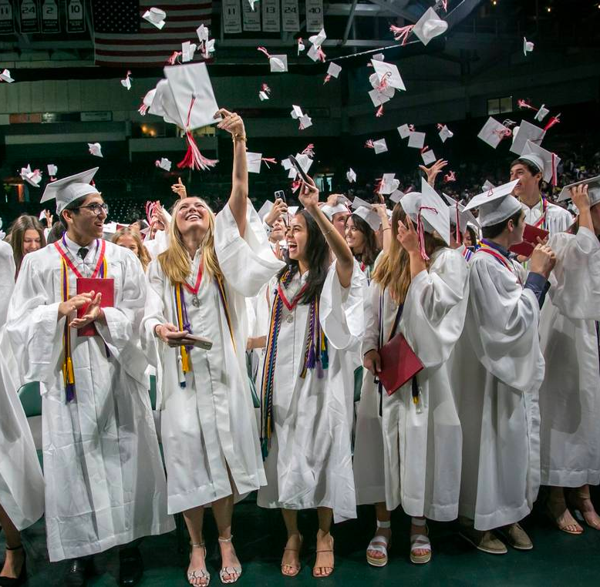
47 SCHOOL DAYS UNTIL GRADUATION!

